Slide 1
Cardiovascular System

Slide 2
Functions:
Transports oxygen and carbon dioxide to and from tissues
Transports nutrients, waste products, and hormones
Regulates body temperature, pH (blood is 7.4)
Restriction of fluid loss during injury
Plays a role in the immune response
3 major structures:
Heart, blood and vessels

Slide 3
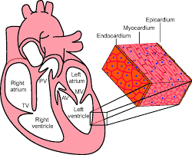
Heart
Endocardium: Innermost layer of the heart
Pericardium: (Epicardium) outer layer, thin sac protects the heart
Myocardium: heart muscle itself

Slide 4
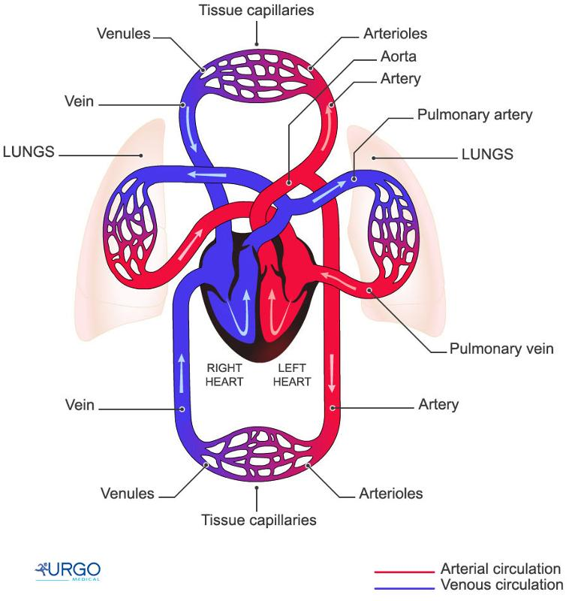
2 different circuits:
Pulmonary → To/from the lungs for exchanges of gases
Systemic → Oxygenated blood distributed to the body

Slide 5
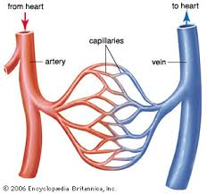
Vessels
Arteries → blood vessels which carry blood from the heart to the body.
Arterioles → smaller branches of arteries
Veins →These are blood vessels that take blood back to the heart; this blood contains less oxygen and is rich in waste products that are to be excreted or removed from the body. Veins become larger as they get closer to the heart.
Venules → smaller branches of veins
Capillaries → microscopic blood vessels which connect arteries and veins together, exchanges of gases occur here

Slide 6
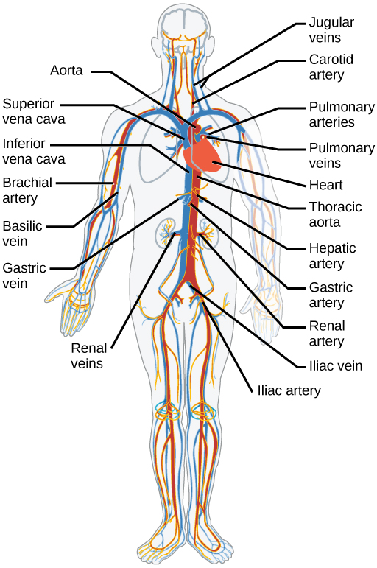
Major Vessels:
Vein → Vena Cava
Artery → Aorta

Slide 7
Blood
Children: The average 80-pound child will have about 2,650 mL of blood in their body, or 0.7 gallons.
Adults: The average adult weighing 150 to 180 pounds should have about 1.2 to 1.5 gallons (9 and 12 pints) of blood in their body.
**The volume of blood in a person's body will vary according to their size and other factors, but the average quantities of blood are as follows: An average-sized woman has about 9 pints of blood. (8 pints in 1 gallon) The amount of blood in the human body is generally equivalent to 7 percent of body weight.

Slide 8
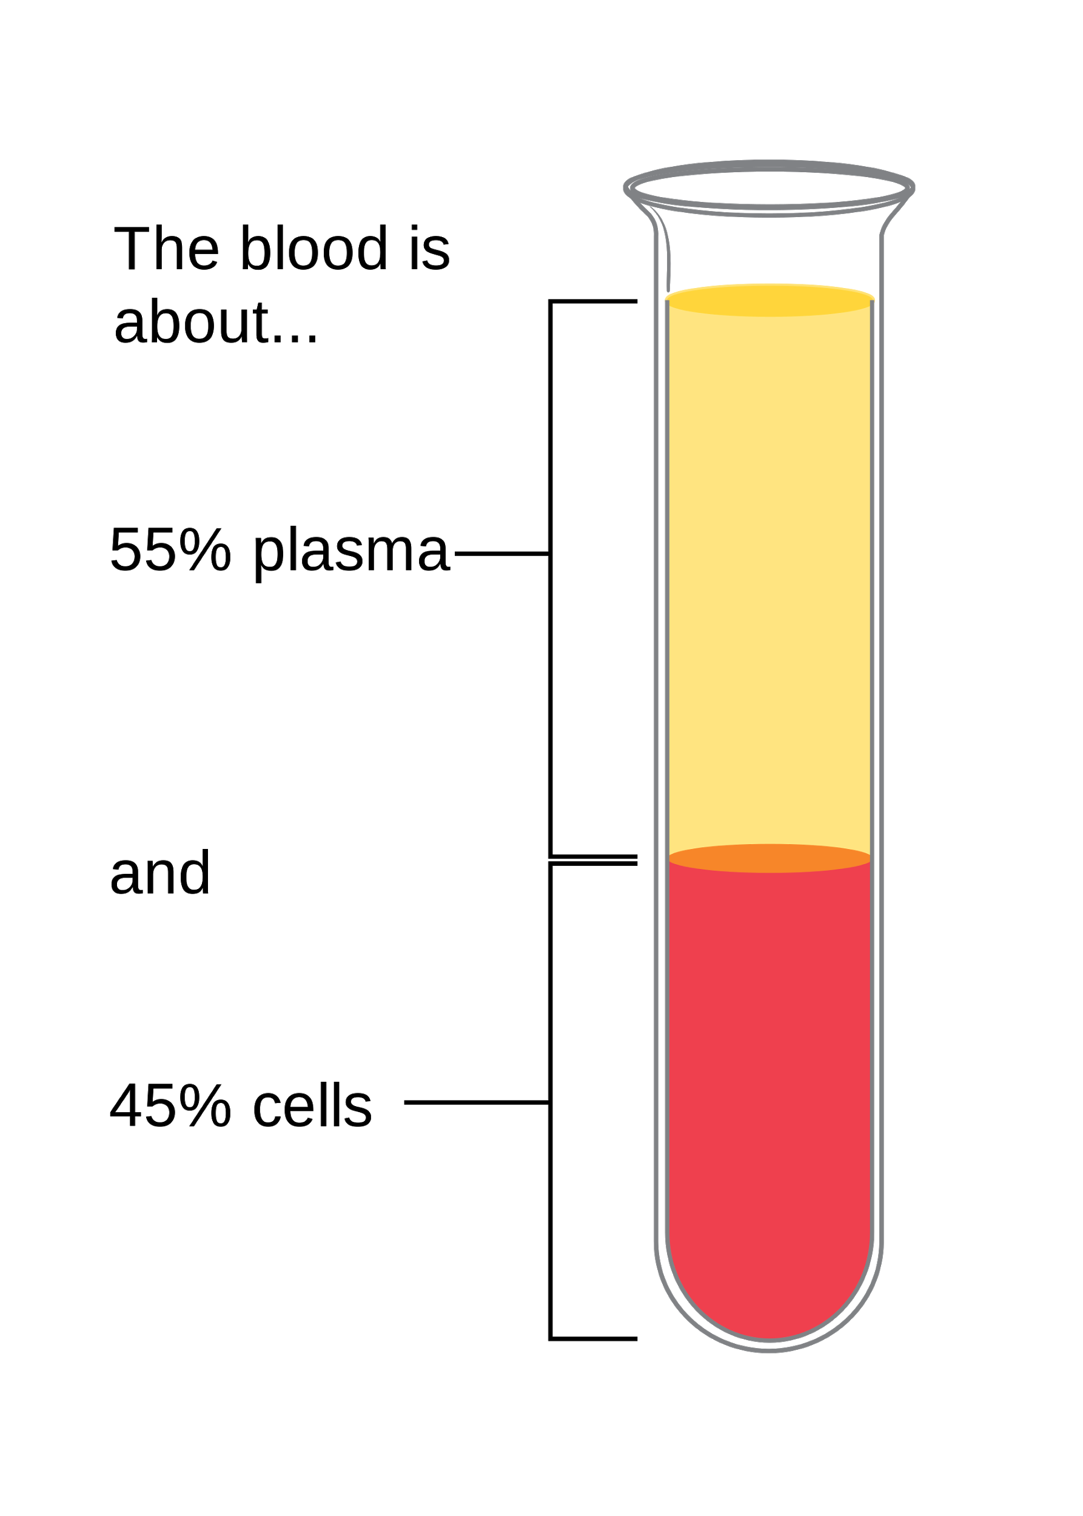
Blood: What is in the blood?
Plasma→ The yellowish liquid part, made of water, salts, and protein. It also contains hormones, nutrients and waste products. Over half of your blood is plasma.
The solid part of your blood contains red blood cells, white blood cells, and platelets.
Erythrocytes→ Red blood cells (RBC) deliver oxygen from your lungs to your tissues and organs.
Leukocytes → White blood cells (WBCs) are the cells of the immune system that are involved in protecting the body against both infectious disease and foreign invaders.
Platelets → tiny blood cells that help your body form clots to stop bleeding.

Slide 10
Blood: What is in the blood?
Plasma→ makes up 55% of the blood volume
Of this → 91% water, 7% Blood Proteins, 2% Nutrients, Hormones and Electrolytes
Erythrocytes→ makes up about 45% of the blood volume
Leukocytes & Platelets → makes up less than 1% of the blood volume

Slide 11
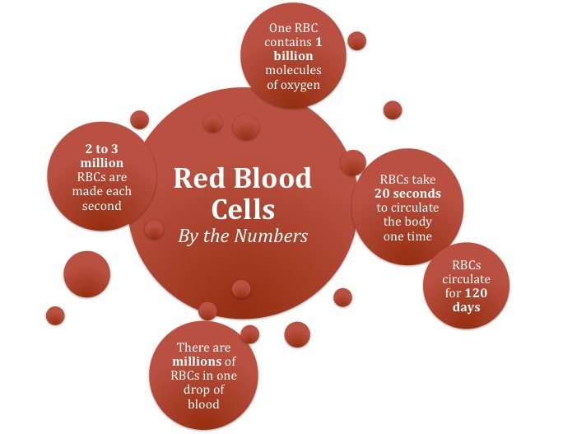

Slide 12
All of us have immune systems, some different than others! All of our cells are covered in antigens.
Antigens: substances that cause an immune response in the body by identifying substances in or markers on cells.
When it detects something not familiar it triggers the release of antibodies that tag foreign body and mark them for termination

Slide 13
2 main types of Antigens → called Agglutinogens
A B
You can have 1 of these antigens, both or neither of these.
If you have one of these, you don't have any antibody for it. So your body will attack it!!!

Slide 14
 | Blood Group | Blood Group | Blood Group | Blood Group
Antigens in Red Blood Cell
Red Blood Cell Type
Antibodies in the Plasma

Slide 15
Another type of antigen we have is call Rhesus, or known as the Rh system (collection of 45 antigens produced as a group, you get all 45 or none)
We either have this antigen or we don’t
Have it Do Not Have It
Rh + Rh -

Slide 16
 | Blood Group A | Blood Group B | Blood Group AB | Blood Group O
Antigens in Red Blood Cell | A | B | AB | NONE
Red Blood Cell Type | A | B | AB | O
Antibodies in the Plasma (who they attack) | Anti- B | Anti- A | NONE | Anti- A and Anti- B
Rhesus Antigen Present (+) **85% of people | A+ | B+ | AB+ | O+
Rhesus Antigen Absent (-) | A- | B- | AB- | O-

Slide 17
Who can accept...
 | Produces antibodies | Can accept
A
B
AB
O
Rh+
Rh-

Slide 18
Blood Type | Anitbodies Produces | Can Accept
AB | Neither | A, B, AB, O
A | B | A, O
B | A | B, O
O | Both | O
Rh factor
Positive |  | Positive or Negative
Negative |  | Negative

Slide 19
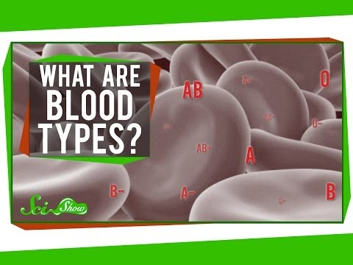

Slide 20
Blood Typing- the testing of a sample of blood to determine an individual's blood group.

Slide 21
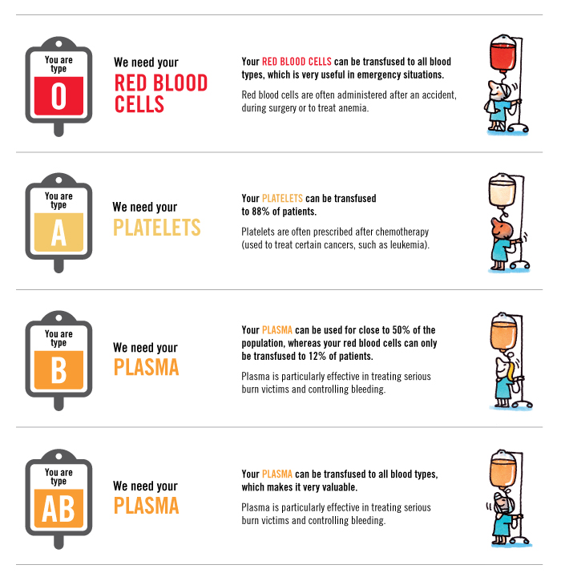

Slide 22
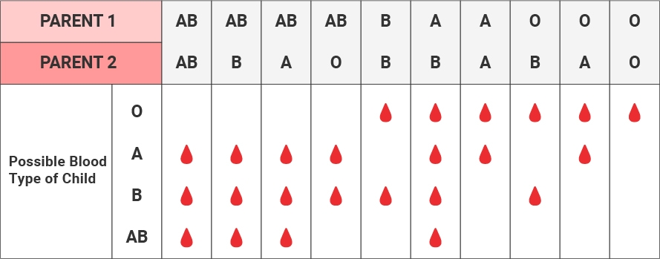

Slide 23
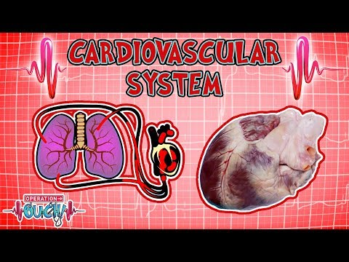

Slide 24
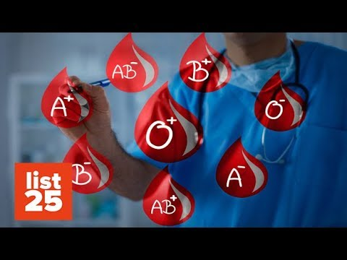

Slide 27
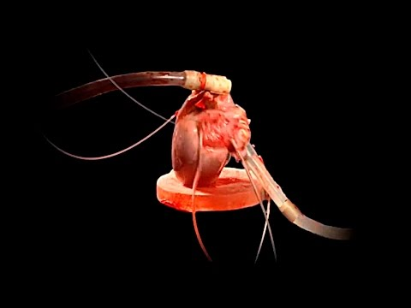
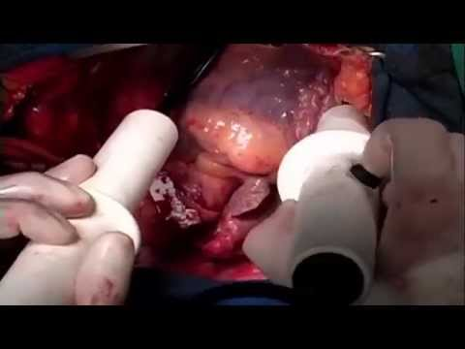
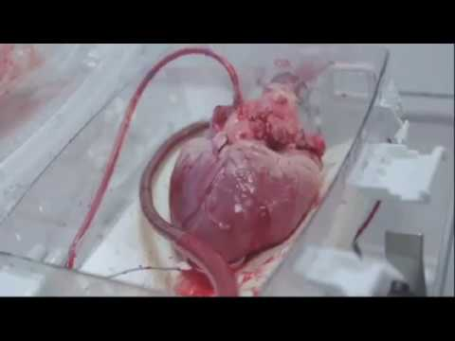
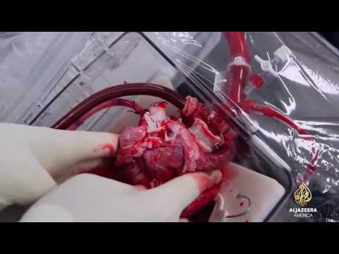

Slide 29
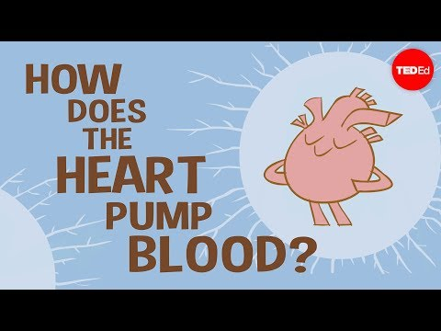

Slide 30
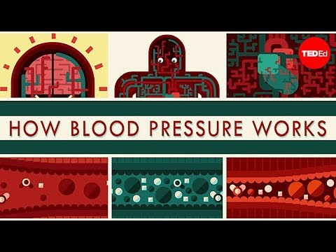

Slide 31
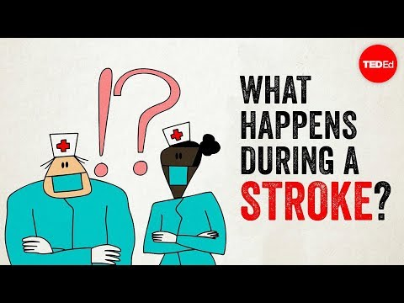
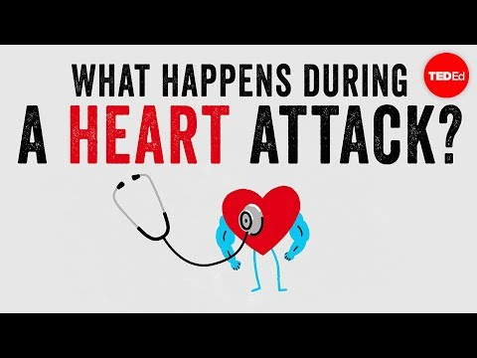

Slide 33
